Slide 1
Deep Learning with PyTorch--Pretrained networks
张新昀
2020.07.22

Slide 2
目录
Part I
Pretrained networks
Part III
NeuralTalk2
Part IV
Torch Hub
Part II
GAN
Part V
Summary

Slide 3
Part I Pretrained networks

Slide 4
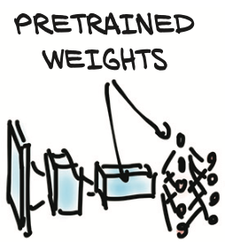
Pretrained networks
预训练网络是一个已经训练好，保存下来的网络，开箱即用
在一个大型数据集上进行了训练（如CV的ImageNet），获得了权重
NLP领域的Bert，GPT3

Slide 5
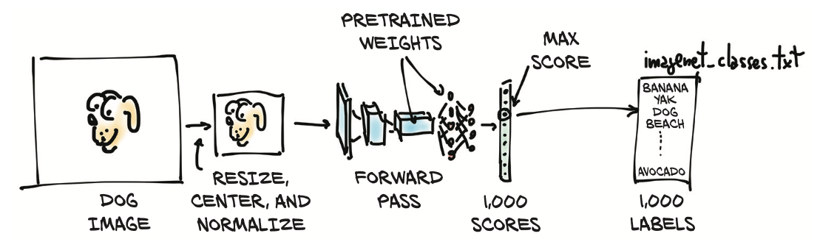
Pretrained networks
The input image will first be preprocessed into an instance of the multidimen- sional array class torch.Tensor.
It is an RGB image with height and width, so this tensor will have three dimensions: the three color channels, and two spatial image dimensions of a specific size.

Slide 6
Pretrained networks
Our model will take that processed input image and pass it into the pretrained network to obtain 1000 scores for 1000 classes(labels). The highest score corresponds to the most likely class according to the weights. Each class is then mapped one-to-one onto a class label.
That output is contained in a torch.Tensor with 1,000 elements, each representing the score associated with that class.

Slide 7
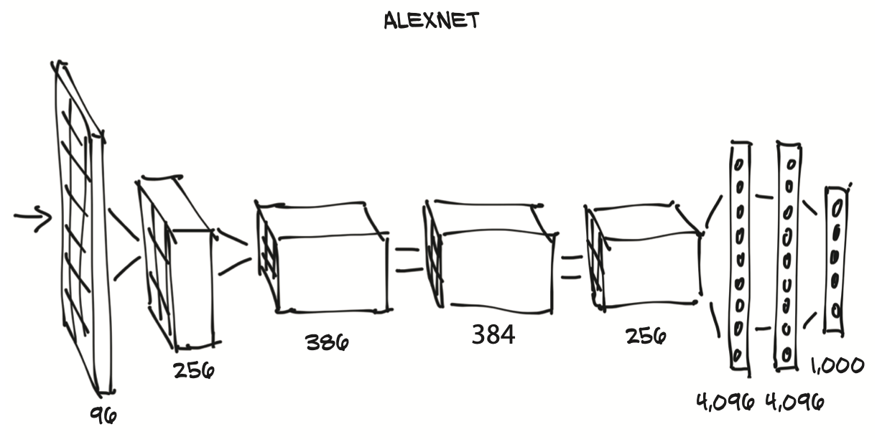
Pretrained networks
The AlexNet architecture won the 2012 ILSVRC by a large margin, with a top-5 test error rate (that is, the correct label must be in the top 5 predictions) of 15.4%. By comparison, the second-best submission, which wasn’t based on a deep network, trailed at 26.2%. This was a defining moment in the history of computer vision: the moment when the community started to realize the potential of deep learning for vision tasks. That leap was followed by constant improvement, with more modern architectures and training methods getting top-5 error rates as low as 3%.

Slide 8
Pretrained networks
pip install torchvision

Slide 9
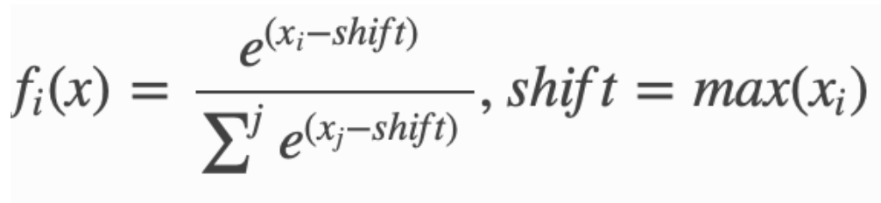
Pretrained networks
torch.nn.functional.softmax( )

Slide 10
Part II GAN

Slide 11
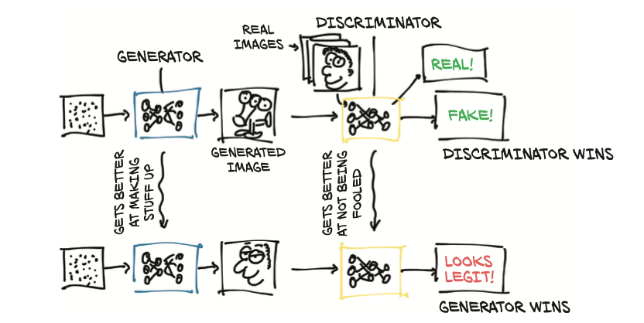
GAN
A generative adversarial network (GAN) is a class of machine learning frameworks. Two neural networks contest with each other in a game (in the sense of game theory, often but not always in the form of a zero-sum game). Given a training set, this technique learns to generate new data with the same statistics as the training set.

Slide 12
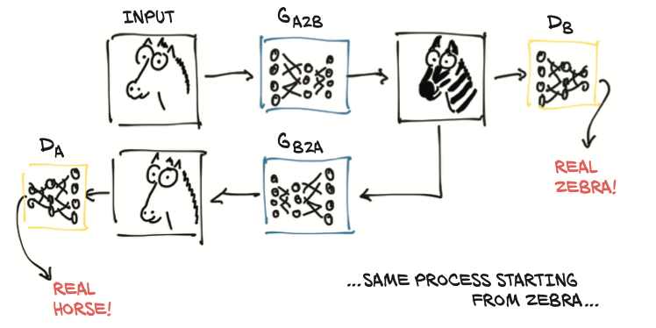
CycleGAN
An interesting evolution of this concept is the CycleGAN. A CycleGAN can turn images of one domain into images of another domain (and back), without the need for us to explicitly provide matching pairs in the training set.

Slide 13
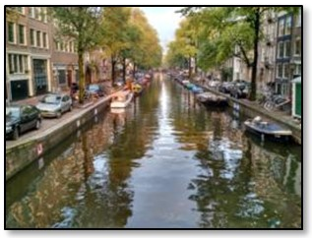
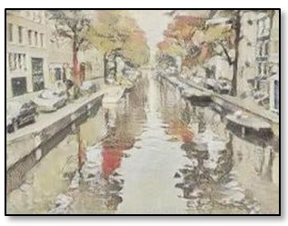
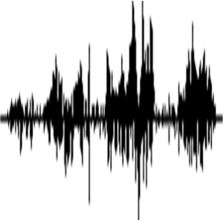
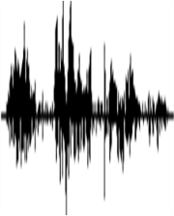
CycleGAN
G
Domain X
Domain Y
Domain X
Domain Y
male
female
It is good.
It is bad.
It’s a good day.
It’s a bad day.
I love you.
I don’t love you
Notes:
landscape photo
Van Gogh
Transform an object from one domain to another without paired data

Slide 14
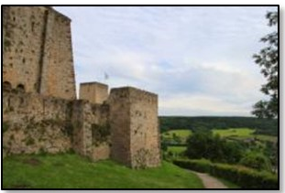
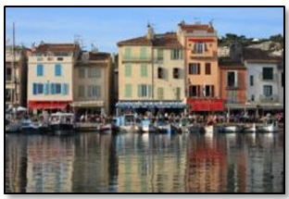
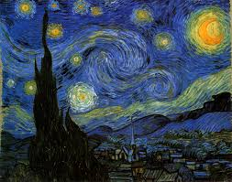
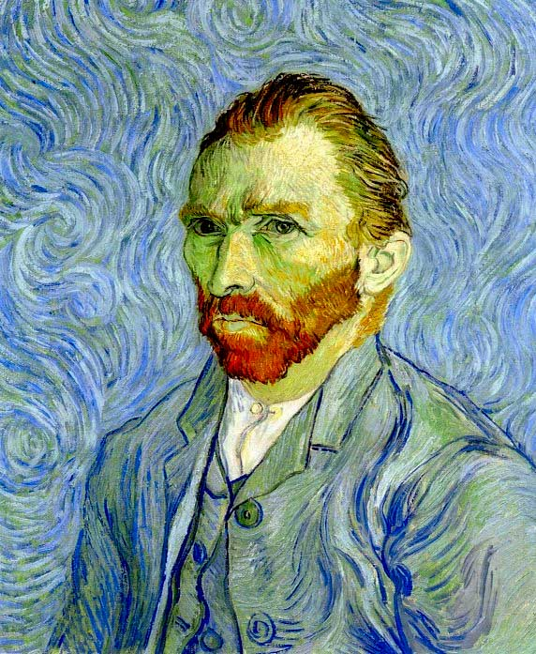
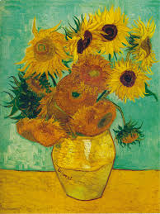
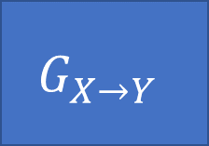

CycleGAN
Domain X
Become similar to domain Y
Domain X
Domain Y
$$G_{X→Y}$$
?
$$D_{Y}$$
scalar
Input image belongs to domain Y or not
Domain Y
Notes:
https://arxiv.org/abs/1703.10593
https://junyanz.github.io/CycleGAN/
Berkeley AI Research (BAIR) laboratory, UC Berkeley

Slide 15
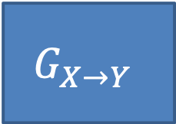
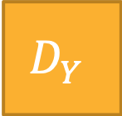
CycleGAN
Become similar to domain Y
Domain X
$$G_{X→Y}$$
Not what we want!
ignore input
$$D_{Y}$$
scalar
Input image belongs to domain Y or not
Domain Y
Notes:
https://arxiv.org/abs/1703.10593
https://junyanz.github.io/CycleGAN/
Berkeley AI Research (BAIR) laboratory, UC Berkeley

Slide 16

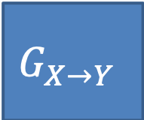
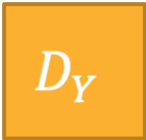
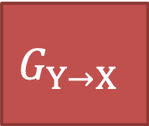
CycleGAN
as close as possible
Cycle consistency
$$G_{X→Y}$$
$$G_{Y→X}$$
Lack of information for reconstruction
$$D_{Y}$$
scalar
Input image belongs to domain Y or not
Domain Y

Slide 17
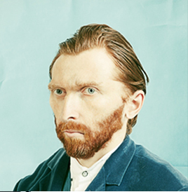
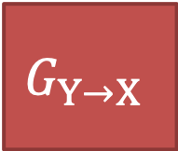
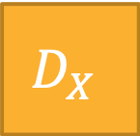
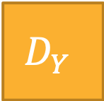
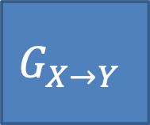
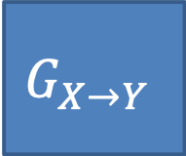
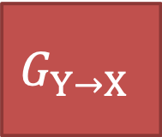
CycleGAN
as close as possible
$$G_{X→Y}$$
$$G_{Y→X}$$
scalar: belongs to domain X or not
$$D_{Y}$$
scalar: belongs to domain Y or not
$$D_{X}$$
$$G_{Y→X}$$
$$G_{X→Y}$$
as close as possible
Notes:
http://sunreader1309.pixnet.net/blog/post/394665458-%E6%94%9D%E5%BD%B1%E8%88%87%E7%95%AB%E4%BD%9C%EF%BC%8C%E6%A2%B5%E8%B0%B7%E8%87%AA%E7%95%AB%E5%83%8F%E7%9A%84%E7%9C%9F%E9%9D%A2%E7%9B%AE%3F--------------

Slide 18
Part III NeuralTalk2

Slide 19
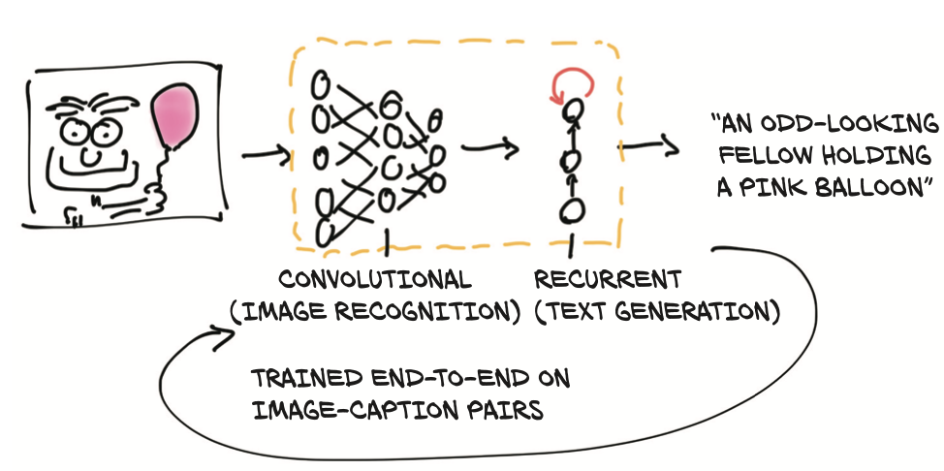
NeuralTalk2
This captioning model has two connected halves. The first half of the model is a network that learns to generate “descriptive” numerical representations of the scene (Tabby cat, laser mouse, paw), which are then taken as input to the second half. That second half is a recurrent neural network that generates a coherent sentence by putting those numerical descriptions together. The two halves of the model are trained together on image-caption pairs

Slide 20
NeuralTalk2
https://github.com/deep-learning-with- pytorch/ImageCaptioning.pytorch
python eval.py --model ./data/FC/fc-model.pth --infos_path ./data/FC/fc-infos.pkl --image_folder ./data

Slide 21
Part IV Torch Hub

Slide 22
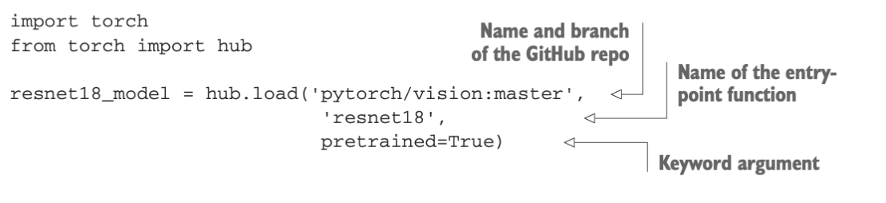
Torch Hub
Pretrained models have been published since the early days of deep learning, but until PyTorch 1.0, there was no way to ensure that users would have a uniform inter- face to get them. TorchVision was a good example of a clean interface, as we saw ear- lier in this chapter; but other authors, as we have seen for CycleGAN and NeuralTalk2, chose different designs.
In our quest for interesting pretrained models, we can now search for GitHub reposi- tories that include hubconf.py

Slide 23
Part V Summary

Slide 24
Summary
A pretrained network is a model that has already been trained on a dataset.Such networks can typically produce useful results immediately after loading the network parameters.
By knowing how to use a pretrained model, we can integrate a neural network into a project without having to design or train it.
AlexNet and ResNet are two deep convolutional networks that set new benchmarks for image recognition in the years they were released.
Generative adversarial networks (GANs) have two parts—the generator and the discriminator—that work together to produce output indistinguishable from authentic items.
CycleGAN uses an architecture that supports converting back and forth between two different classes of images.
NeuralTalk2 uses a hybrid model architecture to consume an image and produce a text description of the image.
Torch Hub is a standardized way to load models and weights from any project with an appropriate hubconf.py file

